Slide 1
Community-Driven Low-Power Wide Area Networking
http://www.openchirp.io

Slide 2
Low-Power Wide Area Networking (LP-WAN)
IoT is ready to leave the building…
Wide area low data-rate and low-power IoT City Networks
Transmitters can send a few bytes per second over kilometers
Sub 1GHz support deeper building penetration
Existing Technologies
NarrowBand IoT (3G cellular IoT channel)
SIGFOX
LoRaWAN (open standard)
Challenges
User / Service / Device Management
Network Management
Data Representation and Sharing
Plugging in Analytics
Security & Privacy

Slide 3


What is OpenChirp?
Management Platform for LP-WAN Networks
Web Portal for sharing and managing data sources
Provides Data context, storage, visualization
Developer API and tools
Sensor
Gateway
Analytics
OpenChirp
Sensor
Access
Visualization
Gateway
Controller
Time Series
DB
Meta
Data
Security
Network
Manager

Slide 4
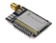
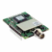
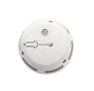
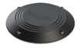


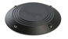
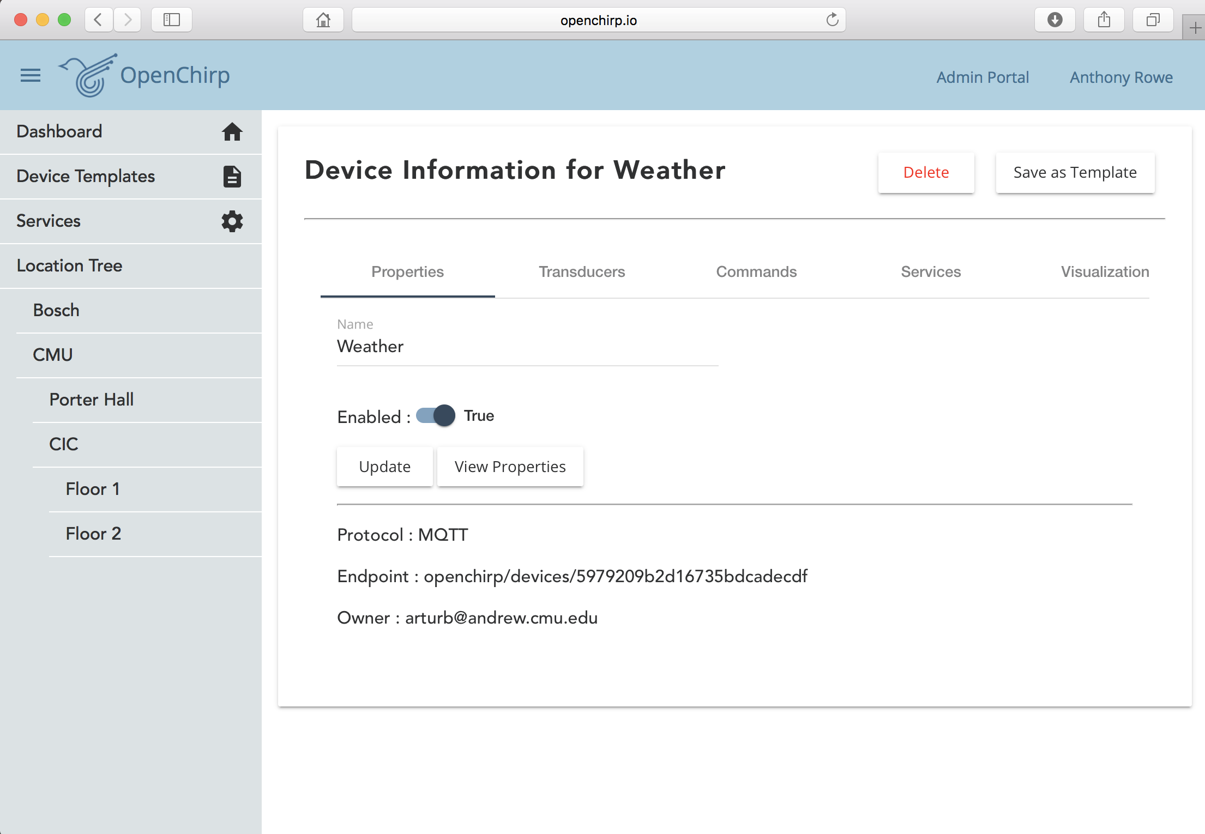
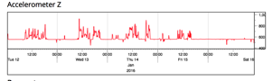

OpenChirp Concept
BLE
Step 1: Login using Google ID
Step 2: Grab a LoRa Device
Step 3: Configure Devices
Step 4: Register on Web Portal
Step 5: Manage Devices
Sounds easy, but there is a lot that needs to be done under the hood…

Slide 5
OpenChirp Features
ProtoBuf serialization from end-device to cloud
MQTT for scalable real-time publish subscribe
Bring your own gateway to crowd-source coverage
REST interface for configuration and management
Open-Source Technologies
Scalable PubSub Architecture (MQTT)
Time Series Datastore (InfluxDB)
Data Visualization and Analytics (Grafana)
REST Interface (node.js)
Authentication (OAuth2 integrated with Google)
Meta Data storage and search (MongoDB)
Energy-Efficient Reference Firmware
Intelligent Network Management

Slide 6
Devices
Transducers
Sensor / Actuator Name, Unit, Value, Timestamp
Commands
Shortcut for writing a value to a transducer
Captures typical ”actuate” requests
Shareable links
Device Templates
Package of common transducers / commands with services

Slide 7

Services
Plug-ins for processing data
“Stackable” setup a processing pipeline
Sensor Values
ProtoBuf
Raw Data
JSON
TSDB
LoRaWAN
EasyBits
Time Series Database

Slide 8
Example Services
Time series data store
Store data in a TSDB like influx
LoRaWAN device
Link a device with a LoRaWAN end-point
LoRaWAN gateway
Link a gateway with a LoRaWAN server
EasyBits
Link a binary stream to Transducers
Trigger
Push a URL on a data event

Slide 9
Security
Authentication
Login with google ID for Authentication (OAuth2)
“Thing” Credentials
Tokens for users, devices and services
Limited domains
Access Control
Users / Groups
Public Links

Slide 10

OpenChirp Architecture
Web Portal
Apps
Tools
REST Interface (node)
Services
Timeseries DB (InfluxDB)
Metadata DB (MongoDB)
Auth / ACL Server (OAuth)
LoRaWAN Server
Data Logger
PubSub Layer. (MQTT)
Gateway
Gateway
Gateway
(optional)
Data flows
HTTP REST
Publish-Subscribe
Sensor
Actuator
Sensor
Actuator
Sensor
FieldBus Protocol
Wire Protocol
Auth Protocol
Sensor
Sensor
Sensor

Slide 11
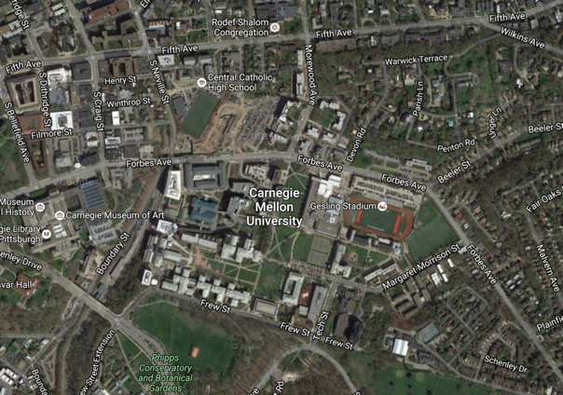
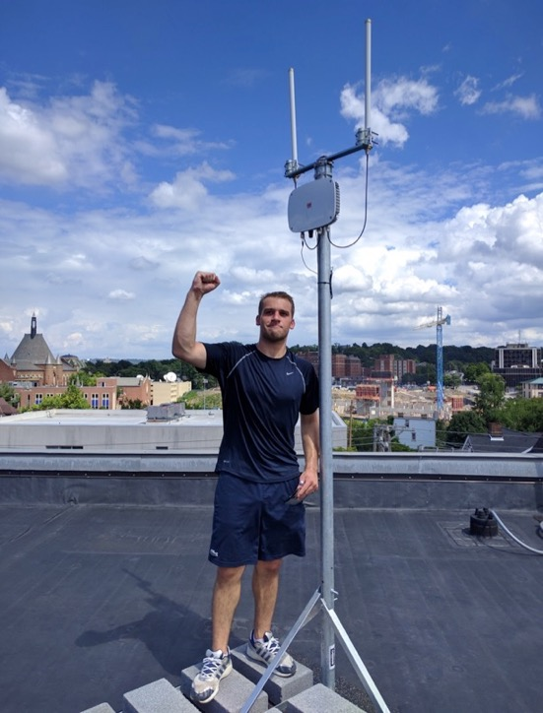
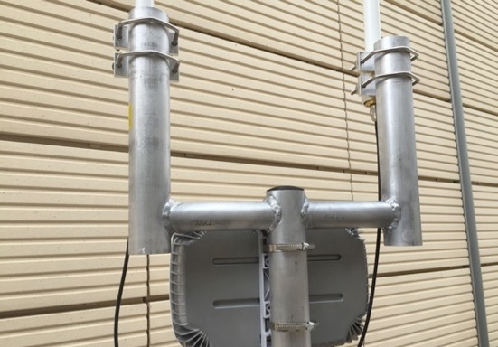
Pilot Deployments
1-λ separated 5.5dBi 902MHz ~ 928MHz
Rooftop Gateway

Slide 12
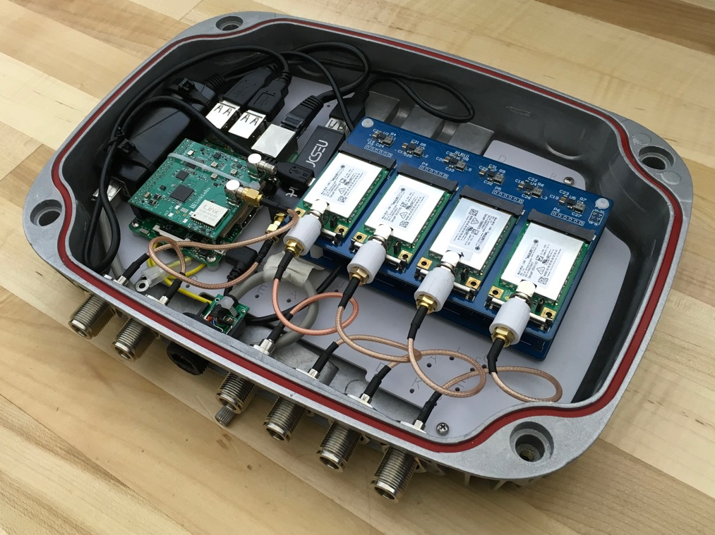
CMU LoRa Gateway
PoE
GPS
RPi 3
SDR
MultiTech AP2 (x8)
32-Chan Concentrator (x2)
stackable

Slide 13
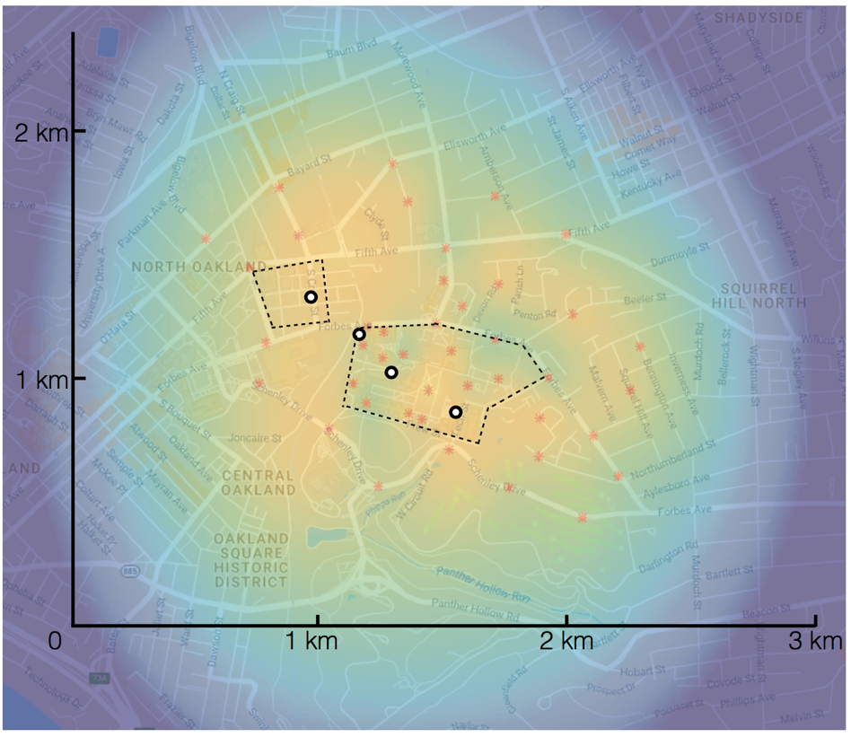
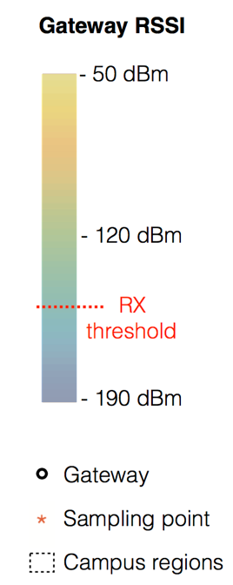
Campus Coverage

Slide 14
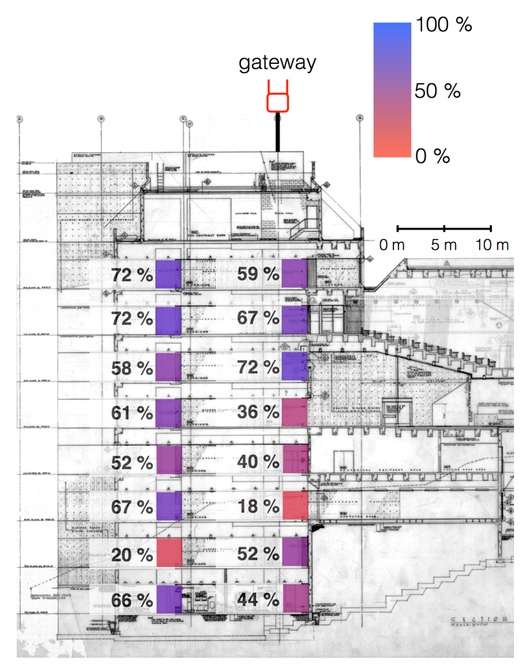
Building Penetration
9 Floor poured concrete building

Slide 15
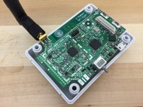
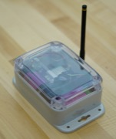
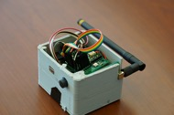
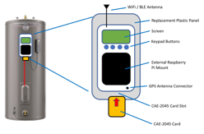
LoRa Devices on Campus
LoRaBug
Open environmental sensor
Monitors environment in remote indoor areas
Laser Ranger
Time-of-flight laser ranger
Monitors structural deflection over time
Occupancy Sensing
Measure people traffic across spaces
Water Heater Controller
Demand-Response peak shifting

Slide 16
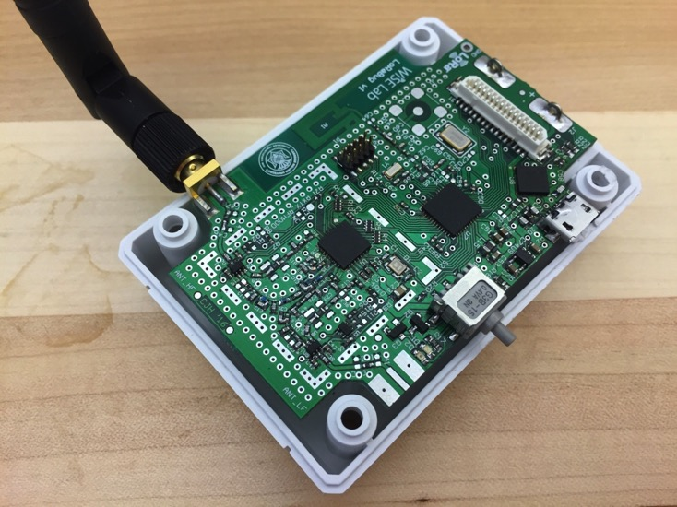
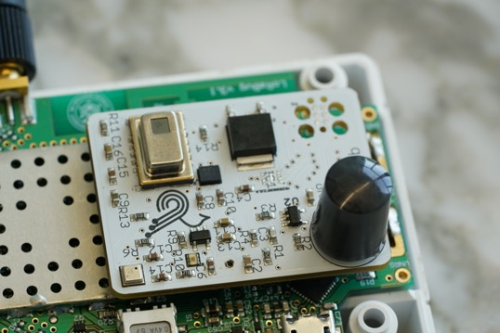
LoRaBug – Sensing Platform
TI CC2650 ARM M3
BLE + 802.15.4
General Purpose
Sensor Header
Sensor Board: Light, Temperature, Accelerometer, Magnetometer, Rate Gyro, Humidity, LEL, Water Contact, Pressure, Audio, PIR motion, 8x8 FLIR imager
5 years @ 15 min
SX1276
LoRa Radio
USB

Slide 17
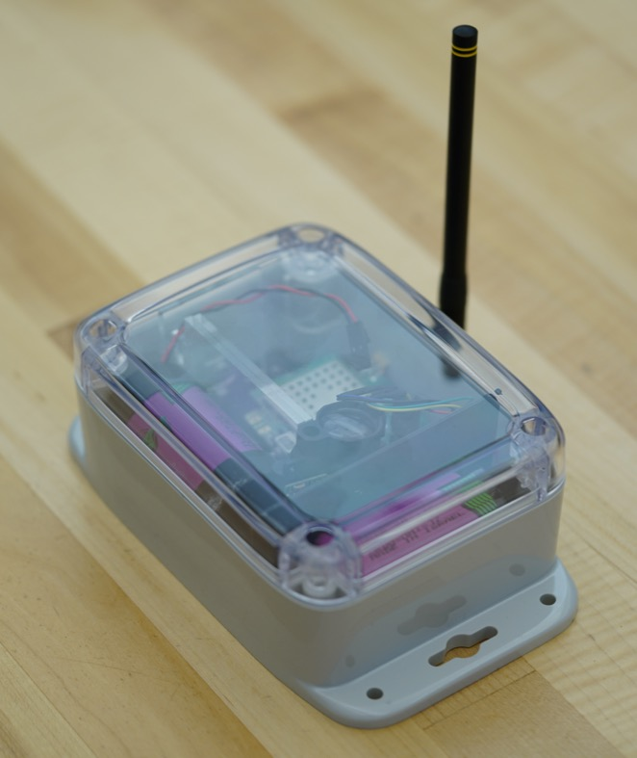
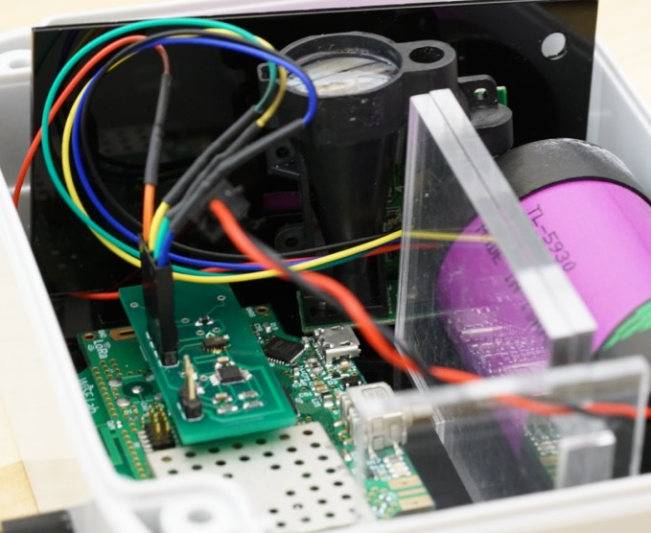
Laser Monitoring
Range: 150m
Resolution: 1mm
Accuracy: 2mm
Lifetime: 5 years @ 15min

Slide 18
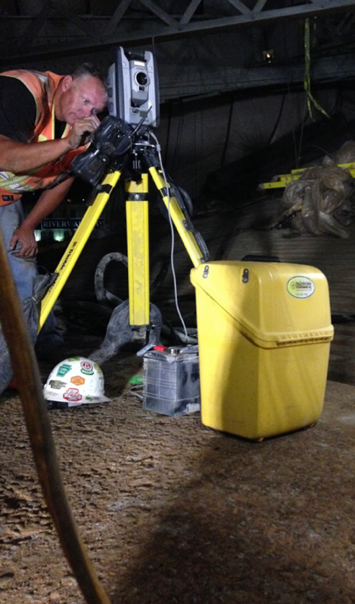
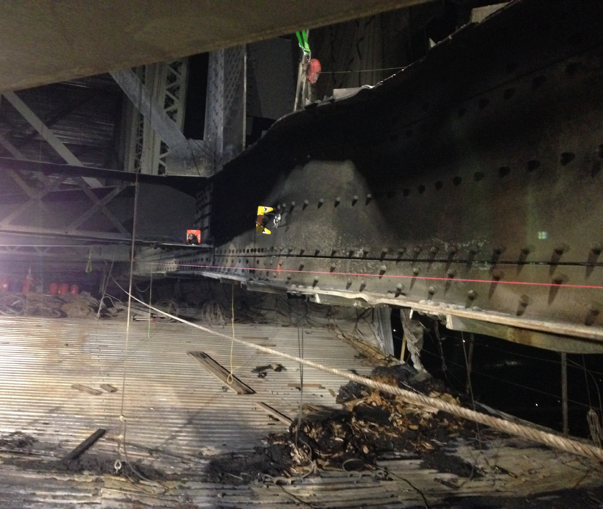
Bridge Monitoring Example

Slide 19
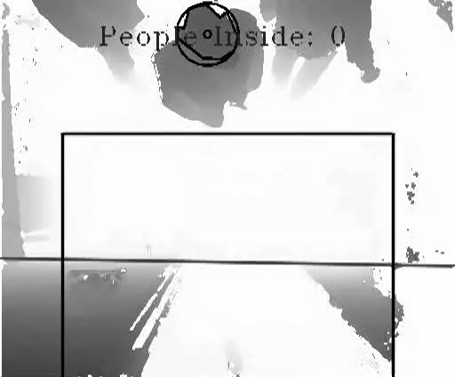
Campus Occupancy Sensing
Door Frame Sensor

Slide 20

GridBallast – Water Heaters
WiFi, BLE and Lora
Electric Water Heater Controller
- Learns Grid load profile (Voltage Frequency / ADR)
- Learns User Patterns
- Platform for Demand Response Algorithms

Slide 21
Research Thrusts
Network Management
Automatic configuration with Bring Your Own Gateway model
Mix of Towers (Macro-cell) and Home APs (Micro-cell)
Decoupling Data / Control Plan to create “OpenFlow” of LP-WAN
Security
Whitespace Offloading
Integrate our framework with FCC database for WS registration
Dual-mode MAC layer
Localization
Collaborative localization with APs and Peers
Improved performance based on RF-modeling and geometry constraints
Application Drivers
Campus sensing
Energy-efficient client support

Slide 22

Thanks, Questions?
http://www.openchirp.io
For more information contact:
General: openchirp@gmail.com
Prof. Anthony Rowe: agr@ece.cmu.edu

